Slide 1
Tasked Based LU Decomposition
By Md Abdul Kader

Slide 2
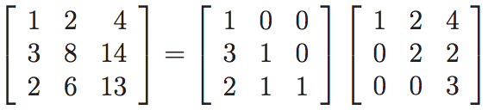
LU Decomposition
A=LU
L=Lower Triangular Matrix
U=Upper Triangular Matrix
Example
A
L
U

Slide 3
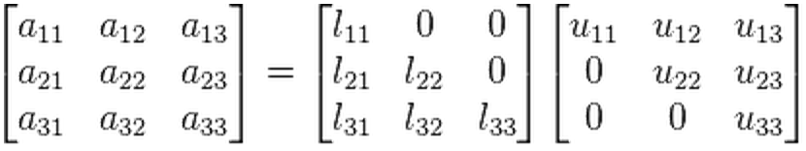
LU Decomposition Problem
Given Matrix A, find matrix L and U.

Slide 4
Solution
Tasked Based Decomposition
To utilize multi-core parallel system

Slide 5
Classic LU Decomposition Algo
Idea:
A=
Solve small sub matrices
Combine the solution of sub matrices
It is Divide and Conquer. That’s the reason to tell it Classic factorization algorithm.
A00 A01
A10 A11

Slide 6
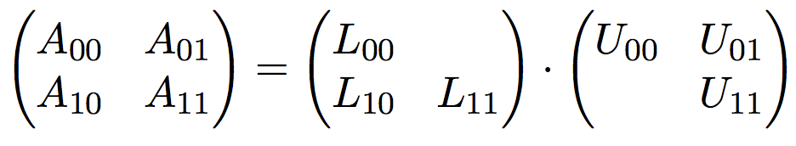
LU-Decomposition Algo …

Slide 7
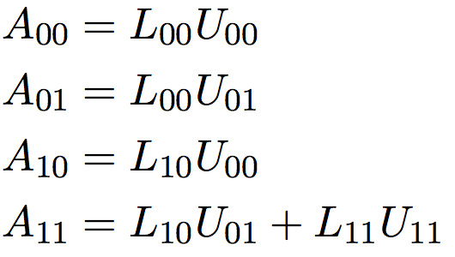
LU-Decomposition Algo …

Slide 8
LU-Decomposition Algo …
STEP1: Smaller sub problem of LU Decomposition

Slide 9
LU-Decomposition Algo …
STEP2: Solve Lower.
A₀₁ and L₀₀ are given, find U₀₁.
L₀₀ is coming from step 1.

Slide 10
LU-Decomposition Algo …
STEP3: Solve Upper.
A₁₀ and U₀₀ are given, find L₁₀.
U₀₀ is coming from step 1.

Slide 11
LU-Decomposition Algo …
STEP4:
iA₁₁=A₁₁-L₁₀ . U₀₁
iA₁₁=L₁₁ . U₁₁
Again smaller sub problem

Slide 12
Task Dependency Graph
STEP1
STEP2
STEP3
STEP4
Possible Concurrency: 2

Slide 13
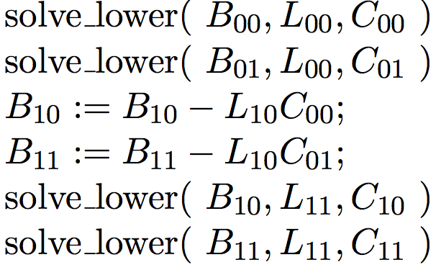
STEP2: Solve Lower
B=LC
Find C where B and L are given.
Using same divide and conquer idea we get below steps.

Slide 14
STEP2: Solve Lower
N
No dependency
N
No dependency
N
No dependency

Slide 15
STEP3: Solve Upper
Similar to Solve Lower

Slide 16
Three recursions
1. LU-Decomposition
2. SolveLower
3. SolveUpper
It took more than 4 hours to figure out the base cases of all those recursions.

Slide 17
My Approach
Implemented Non-threaded version.
Threaded version with OpenMP task
It was crashing because of thread unsafe C++ STL vector.
Then I replaced vector with my own dynamic array.
Threaded version using Cilk

Slide 18
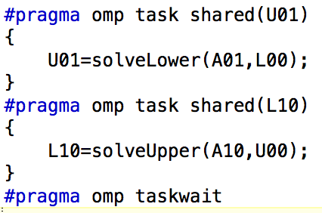

Code snippets
Figure: Cilk implementation
Figure: OpenMP implementation

Slide 19
Tuning

Slide 20
Tuning: Magic Number 4
No spawning if sub problem size if less than or equal 4.
Switching to sequential version of SolveLower/SolveUpper if sub problem size is less than 4.
Number of Threads = 4

Slide 21
Performance
Matrix Dimension (NxN) | Sequential Time (s) | OMP Time (s) | Cilk Time (s)
500x500 | 0.235685 | 0.217672 | 0.176355
1000x1000 | 1.416806 | 1.537784 | 1.126999
1500x1500 | 6.030336 | 5.027035 | 3.159244
2000x2000 | 14.08154 | 11.523919 | 6.24722
2500x2500 | 31.599557 | 26.912589 | 11.554249
3000x3000 | 61.703155 | 44.40926 | 19.438269
4000x4000 | Mem Overflow | Mem Overflow | Mem Overflow

Slide 22
Performance
Matrix Dimension (NxN) | Sequential Time (s) | OMP Time (s) | Cilk Time (s)
500x500 | 0.235685 | 0.217672 | 0.176355
1000x1000 | 1.416806 | 1.537784 | 1.126999
1500x1500 | 6.030336 | 5.027035 | 3.159244
2000x2000 | 14.08154 | 11.523919 | 6.24722
2500x2500 | 31.599557 | 26.912589 | 11.554249
3000x3000 | 61.703155 | 44.40926 | 19.438269
4000x4000 | Mem Overflow | Mem Overflow | Mem Overflow

Slide 23
Performance

Slide 24
References
http://www.mis.mpg.de/preprints/2014/preprint2014_5.pdf
http://www.kriemann.name/Ronald/publications/winterschool2014-1.pdf
http://mathworld.wolfram.com/LUDecomposition.html

